Slide 1
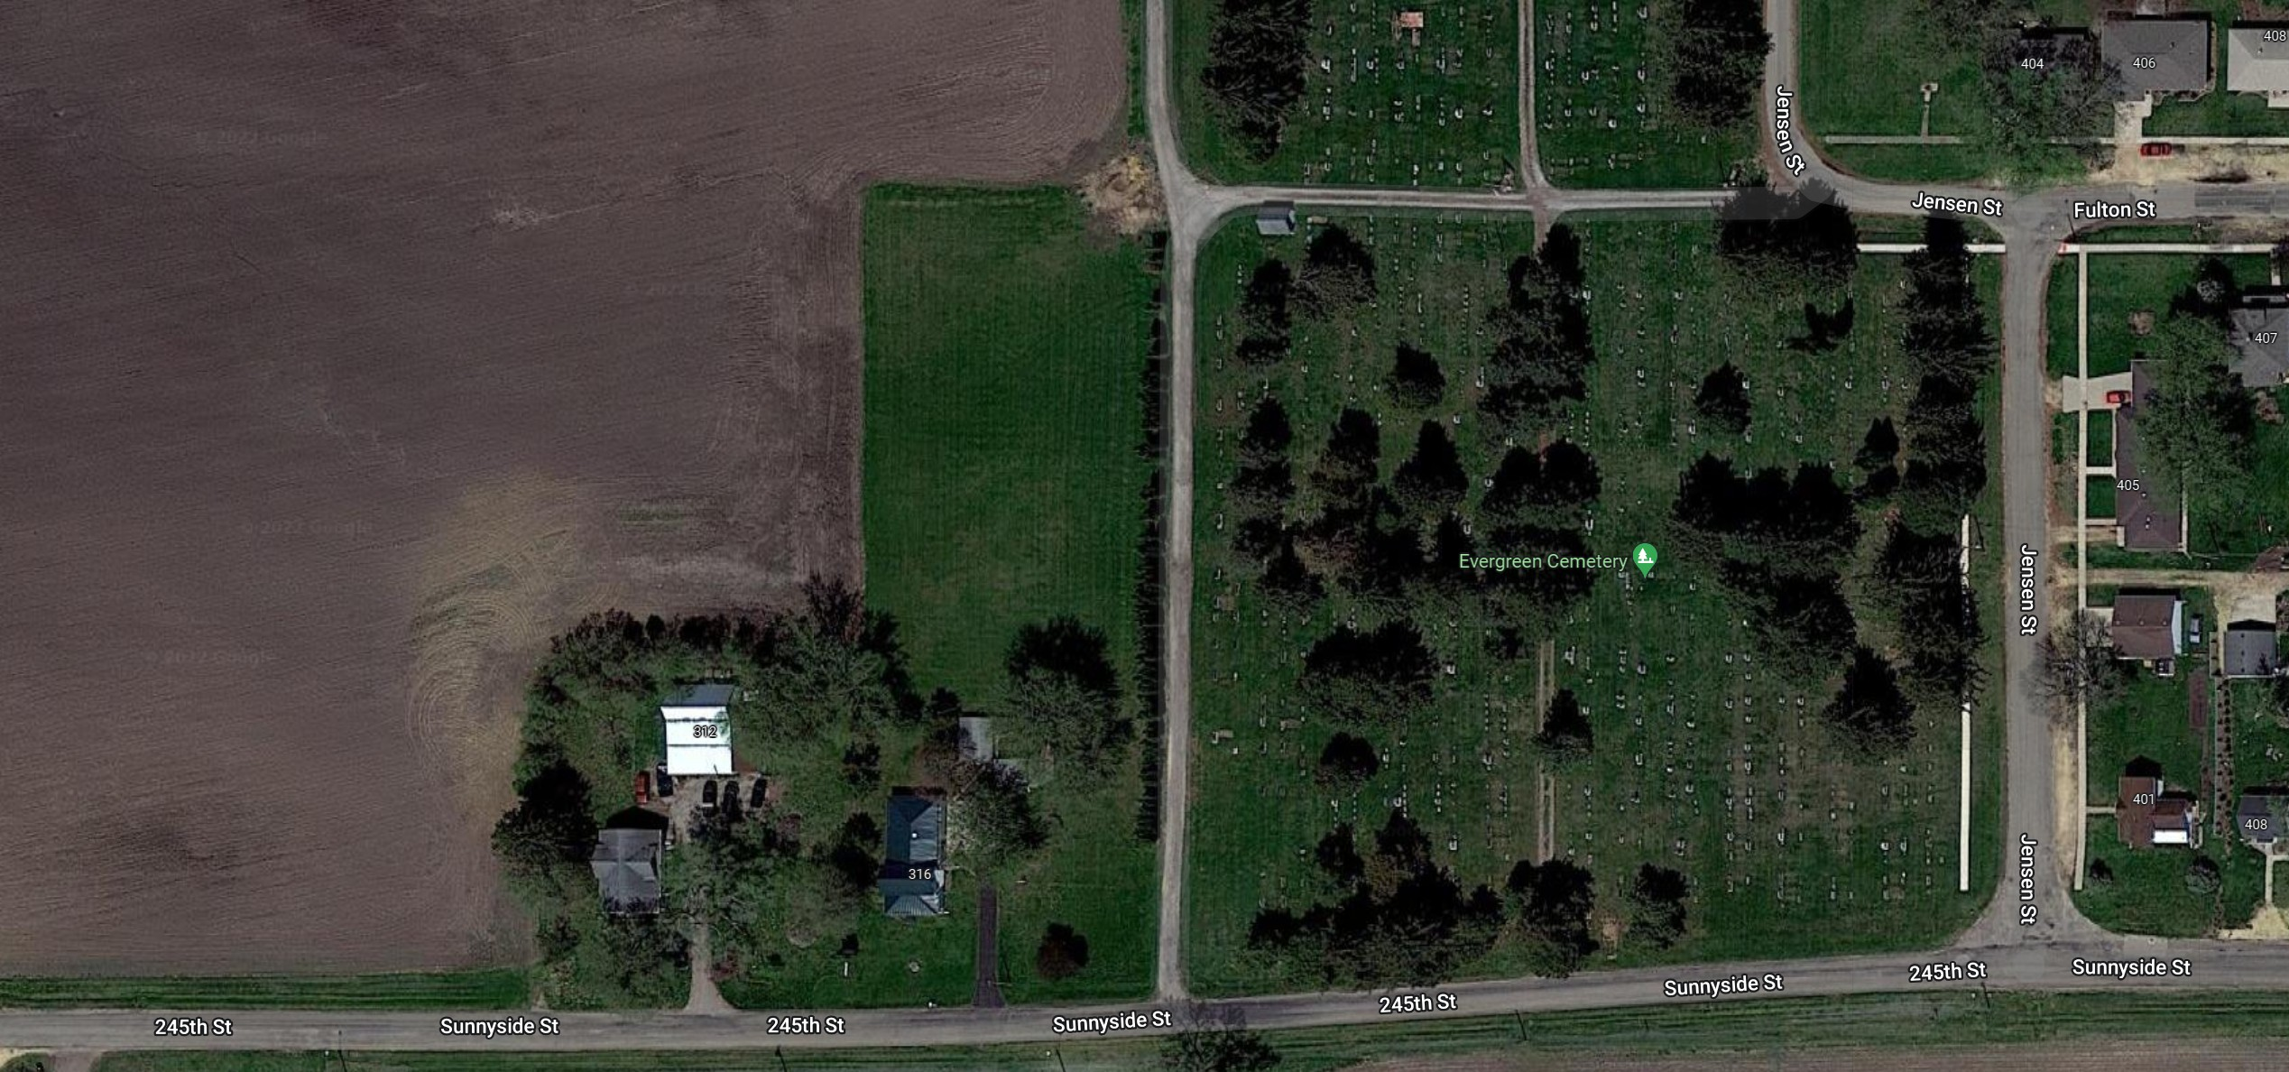
8/25/22, 2:25 PM
Google Maps
New Section to be plotted
7
Block 4
Block 1
Block 5
8
Block 3
Block 2
Block 6
9
Imagery ©2022 Maxar Technologies, Map data ©2022 50 ft
https://www.google.com/maps/@41.8225716,-90.655778,176m/data=!3m1!1e3
1/1

